Slide 1
PlayList musicale versione Java Script
Progetto TIW 2020/2021
Matteo Nunziante

Slide 2
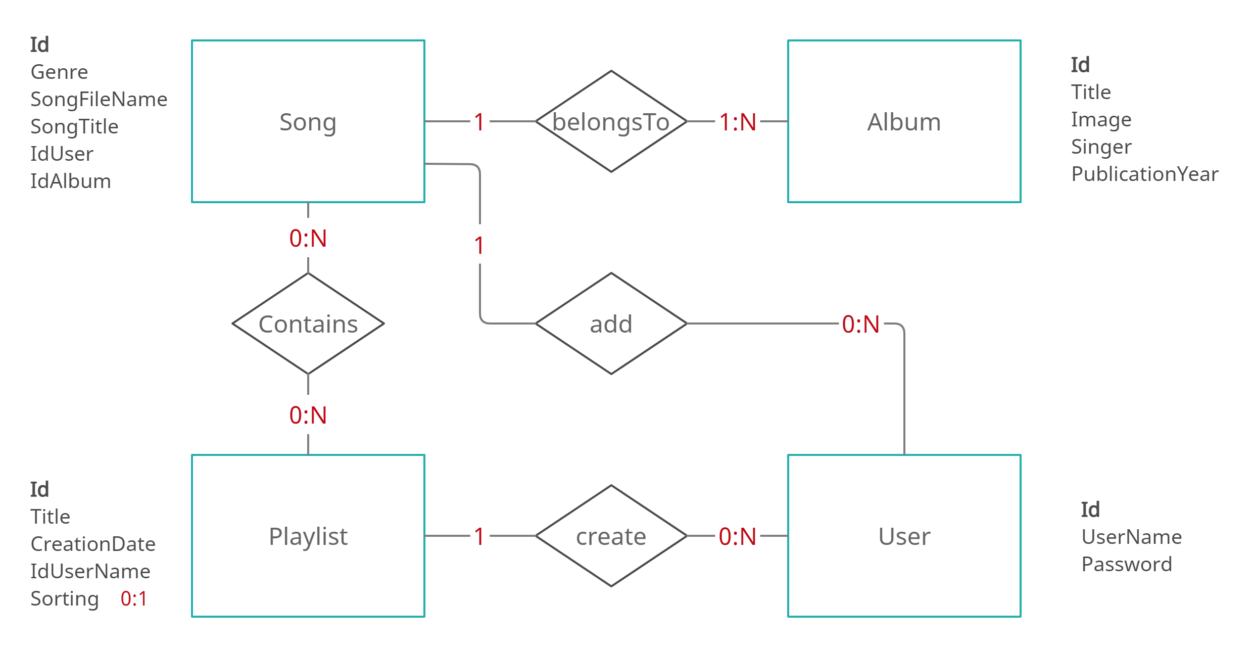
Data Base design

Slide 3
Data Base design
Logical scheme:
USER(Id , UserName , Password)
PLAYLIST(Id , Title , CreationDate , IdUserName , Sorting)
ALBUM(Id , Title , Image , Singer , PublicationYear)
SONG(Id , Genre , SongFileName , SongTitle , IdUser , IdAlbum)
CONTAINS(IdPlaylist , IdSong)
Foreign keys:
PLAYLIST.IdUserName -> USER.id
SONG.IdUser -> USER.id , SONG.IdAlbum -> ALBUM.Id
CONTAINS.IdPlaylist -> PLAYLIST.Id , CONTAINS.IdSong -> SONG.Id

Slide 4
Table definition: user/playlist
CREATE TABLE `user` (
`Id` int NOT NULL AUTO_INCREMENT,
`UserName` varchar(45) NOT NULL,
`Password` varchar(45) NOT NULL, PRIMARY KEY (`Id`)
)
CREATE TABLE `playlist` (
`Id` int NOT NULL AUTO_INCREMENT,
`IdUserName` int NOT NULL,
`Title` varchar(45) NOT NULL,
`CreationDate` date NOT NULL,
`Sorting` json DEFAULT NULL,
PRIMARY KEY (`Id`), KEY `IdUser_idx`
(`IdUserName`), CONSTRAINT `IdUserName`
FOREIGN KEY (`IdUserName`) REFERENCES
`user` (`Id`) ON DELETE CASCADE ON UPDATE
CASCADE
)

Slide 5
Table definition: song/album
CREATE TABLE `album` (
`Id` int NOT NULL AUTO_INCREMENT,
`Title` varchar(45) NOT NULL,
`Image` varchar(255) NOT NULL,
`Singer` varchar(45) NOT NULL,
`PublicationYear` varchar(45) NOT NULL,
PRIMARY KEY (`Id`)
)
CREATE TABLE `song` (
`Id` int NOT NULL AUTO_INCREMENT,
`IdUser` int NOT NULL,
`KindOf` varchar(45) NOT NULL,
`MusicFile` varchar(255) NOT NULL,
`SongTitle` varchar(45) NOT NULL,
`IdAlbum` int NOT NULL,
PRIMARY KEY (`Id`), KEY `IdAlbum_idx`
(`IdAlbum`), KEY `IdUser_idx` (`IdUser`),
CONSTRAINT `IdAlbum` FOREIGN KEY
(`IdAlbum`) REFERENCES `album` (`Id`) ON
DELETE CASCADE ON UPDATE CASCADE,
CONSTRAINT `IdUser` FOREIGN KEY (`IdUser`)
REFERENCES `user` (`Id`) ON DELETE
CASCADE ON UPDATE CASCADE
)

Slide 6
Table definition: contains
CREATE TABLE `contains` (
`IdSong` int NOT NULL,
`IdPlaylist` int NOT NULL,
PRIMARY KEY (`IdSong`,`IdPlaylist`), KEY
`IdPlaylist_idx` (`IdPlaylist`),
CONSTRAINT `IdPlaylist` FOREIGN KEY
(`IdPlaylist`) REFERENCES `playlist` (`Id`)
ON DELETE CASCADE ON UPDATE
CASCADE,
CONSTRAINT `IdSong` FOREIGN KEY
(`IdSong`) REFERENCES `song` (`Id`) ON
DELETE CASCADE ON UPDATE CASCADE
)

Slide 7
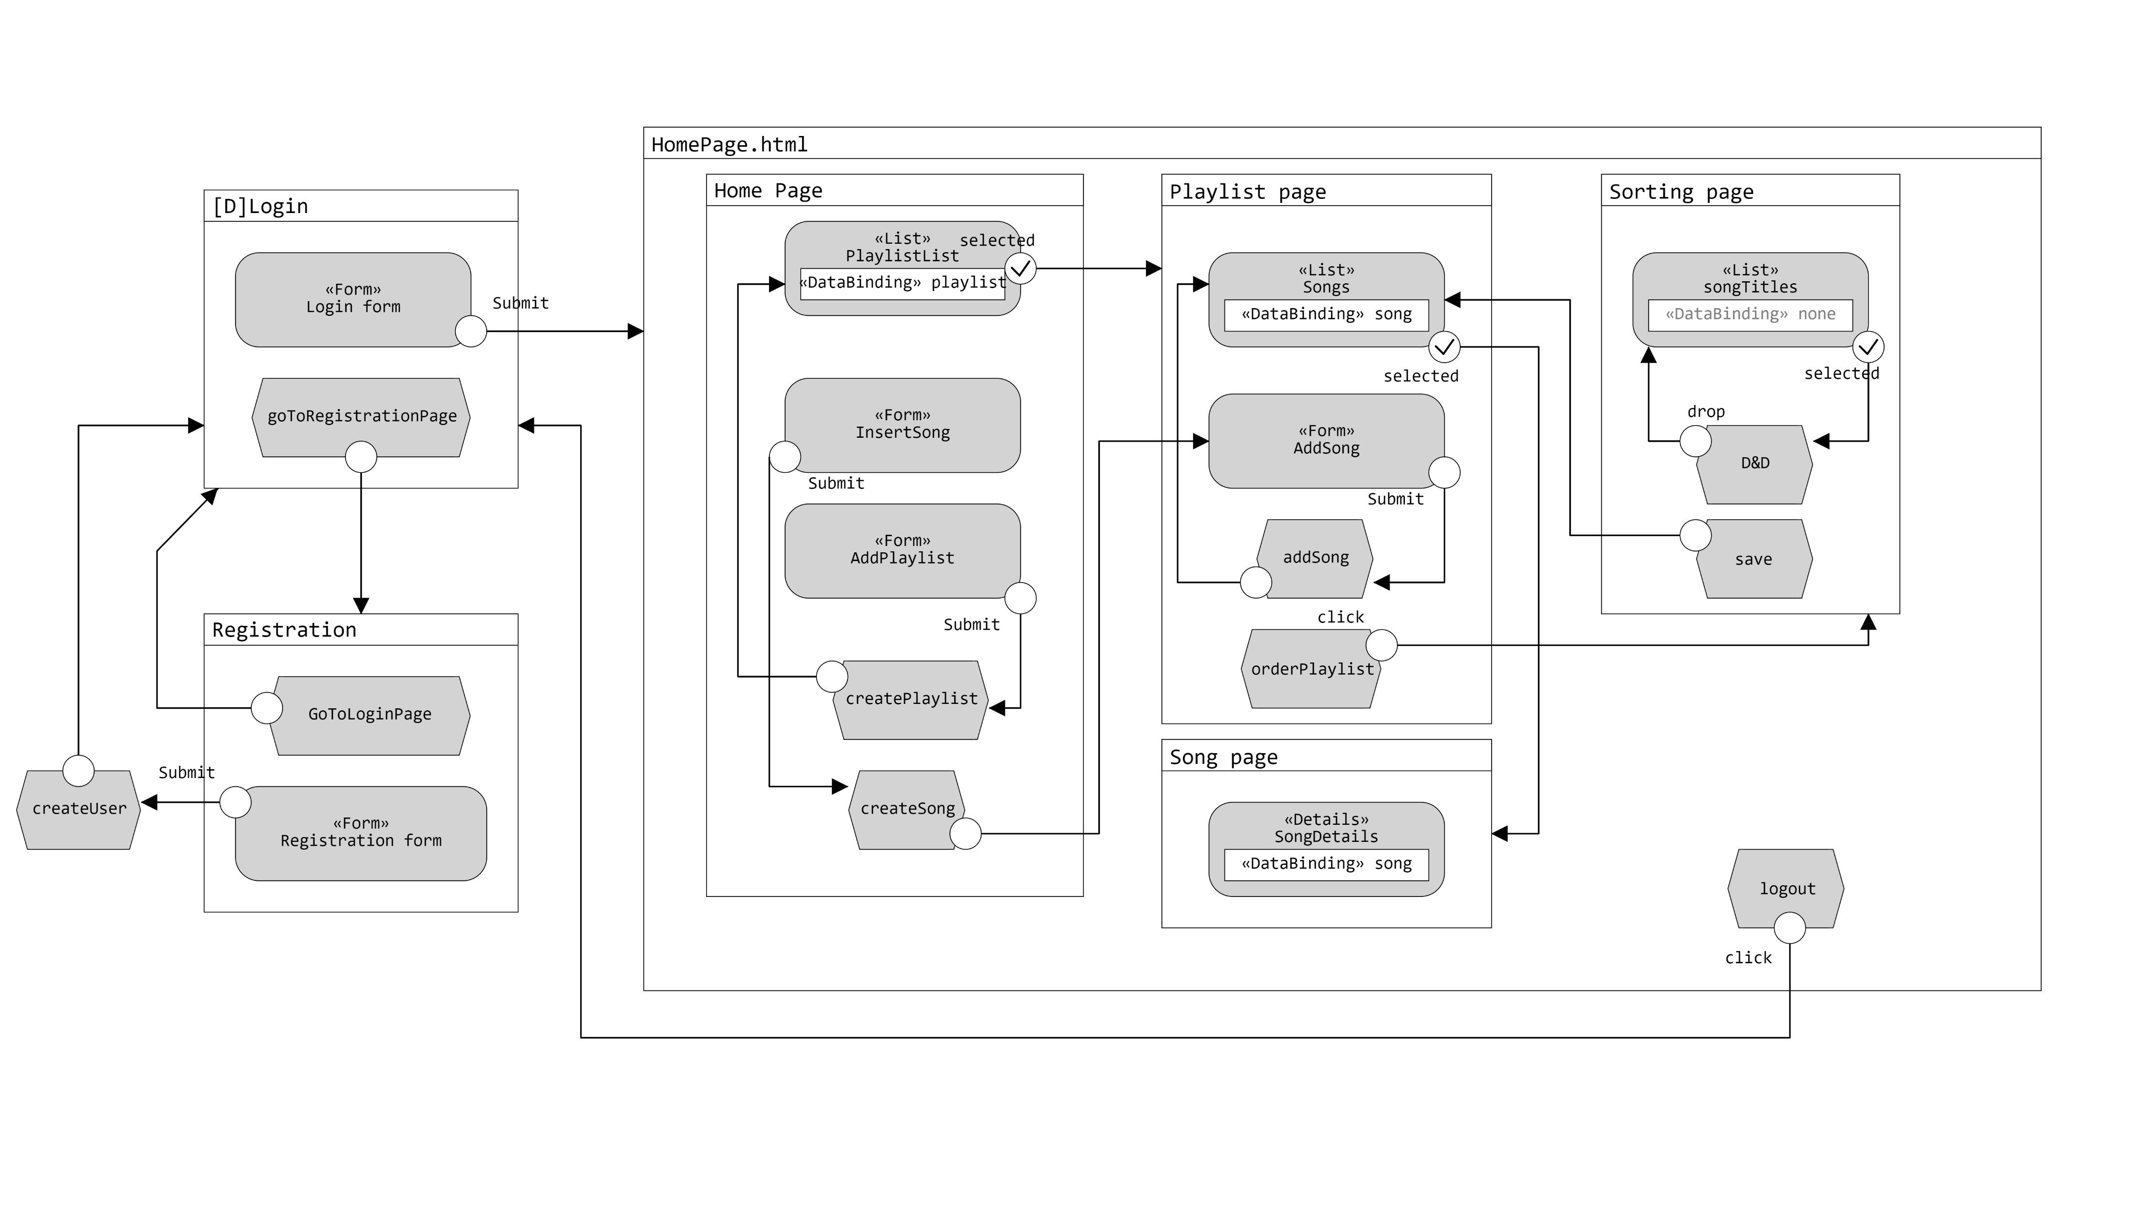
Application Design(IFML)

Slide 8
Components
Model Objects (Beans)
User
Playlist
SongDetails
Views (Templates)
Login.html
Registration.html
HomePage.html
Utils
ConnectionHandler
FromJsonToArray
GetEncoding
Controllers (Servlets)
CheckLogin
Registration
GetPlaylistList
CreateSong
CreatePlaylist
GetSongsInPlaylist
GetSongsNotInPlaylist
AddSong
AddSorting
GetSongDetails
Logout
Filters
LoginChecker

Slide 9
Components:Data Access Objects (Classes)
UserDAO
+findUser(userName)
+checkAuthentication(userName , password)
+addUser(username , password)
PlaylistDAO
+findPlaylist(userId)
+findPlaylistbyTitle(title , userId)
+createPlaylist(title , creationDate , userId)
+findPlaylistById(playlistId , userId)
+findPlaylistTitleByID(playlistId)
+addSong(playlistID , songId)
+findSongInPlaylist(playlistId , songId)
+addSorting(int playlistId , String jSonSorting)
+getSorting(int playlistId)
SongDAO
-findAlbumId(albumTitle , singer , publicationYear , filename)
+createSongAndAlbum(userId , songTitle , genre , albumTitle , singer , publicationYear , imgName , songName)
-createAlbum(albumTitle , singerr , publicationYear , filename)
-createSong(userId , songTitle , genre , albumId , filename)
+getSongTitleAndImage(playlistId)
+getSongsNotInPlaylist(playlistId , userId)
+findSongByUser(songId , userId)
+findImageByUser(imageName , userId)
+getSongDetails(songId)
+findSongByUserId(songName , userId)

Slide 10
Sequence diagrams
Semplificazioni:
Per semplicità e maggior chiarezza sono stati omessi i controlli sui parametri in ingresso
Ogni richiesta al server successiva al login passa attraverso il filtro ‘LoginChecker’ il quale verifica se la sessione è valida e se l’utente è loggato, ovvero se l’attributo ‘user’ nella request non è null

Slide 11
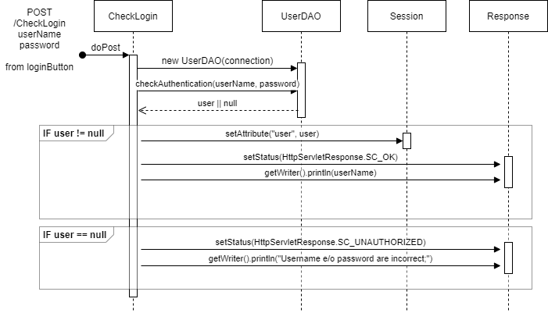
Event: login

Slide 12
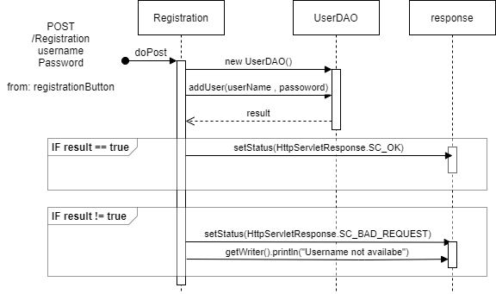
Event: registration

Slide 13
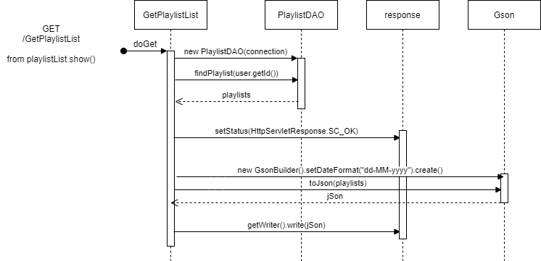
Event: get playlist list

Slide 14
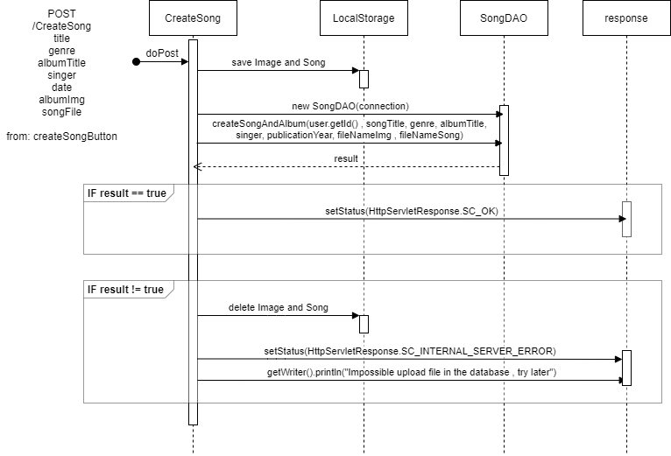
Event: create a new song

Slide 15
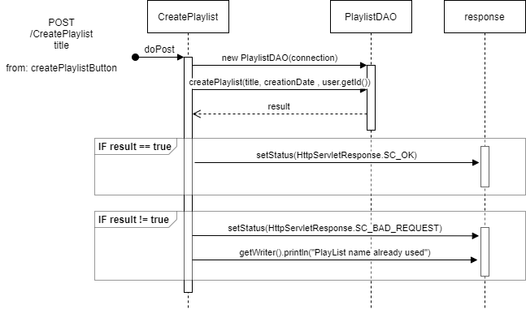
Event: create a new playlist

Slide 16
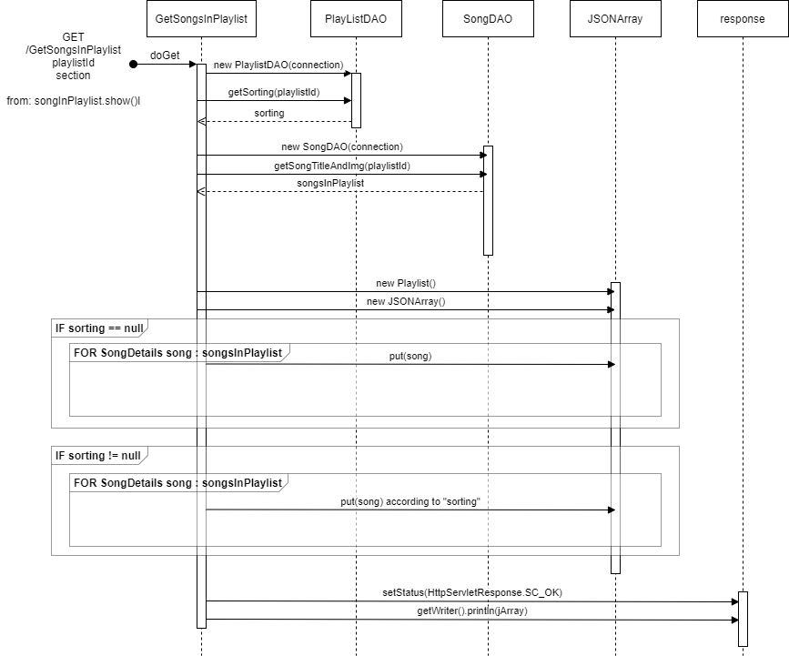
Event: get songs in playlist

Slide 17
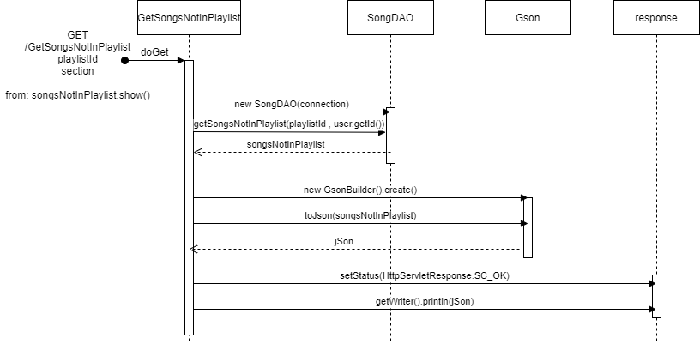
Event: get songs not in playlist

Slide 18
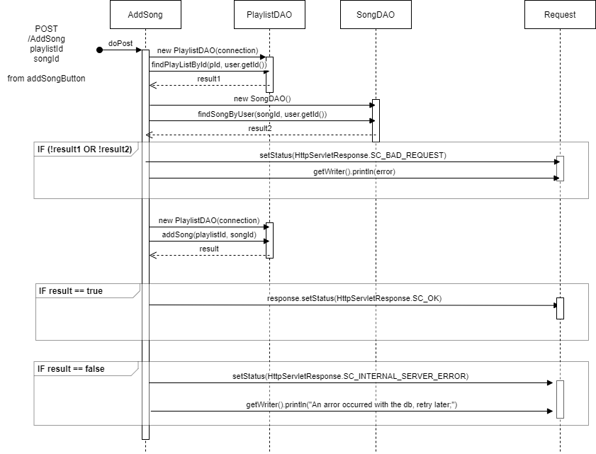
Event: add songs

Slide 19
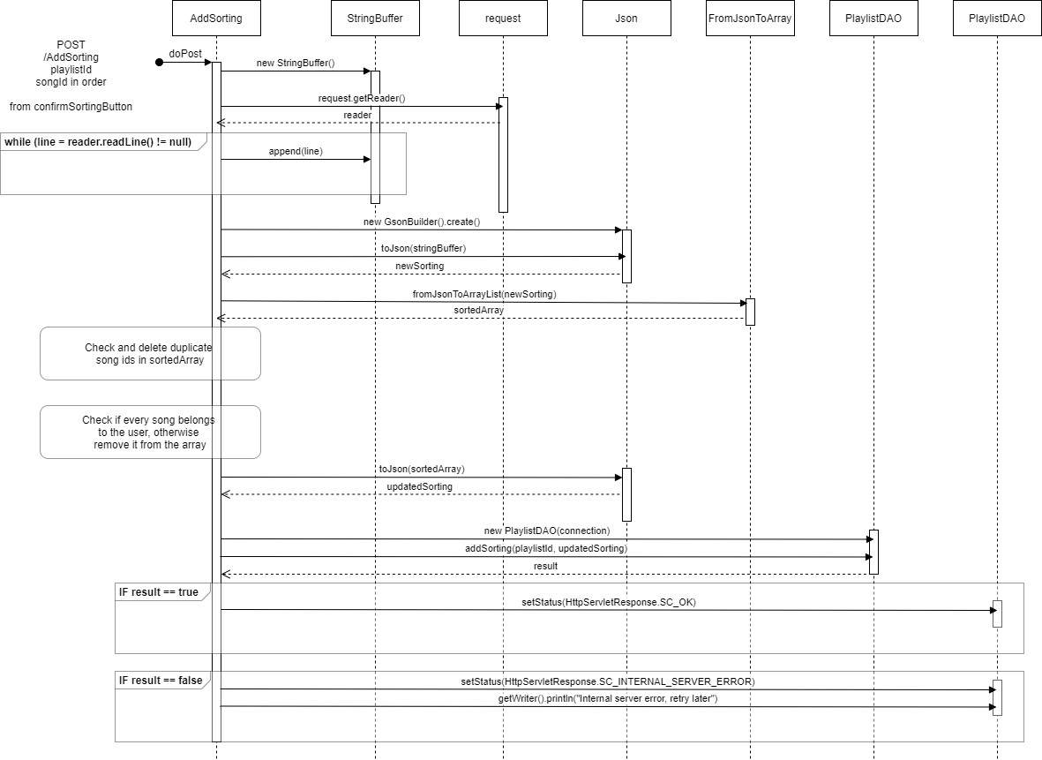
Event: add sorting to a playlist

Slide 20
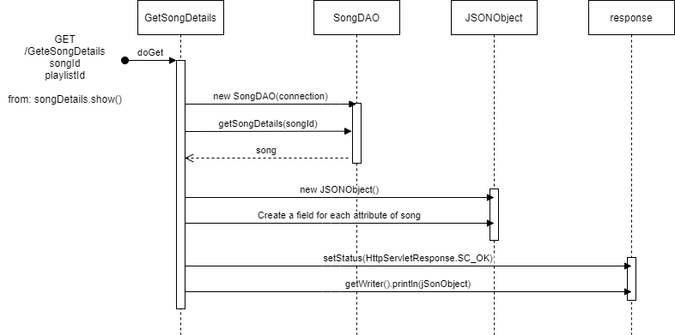
Event: get song details

Slide 21
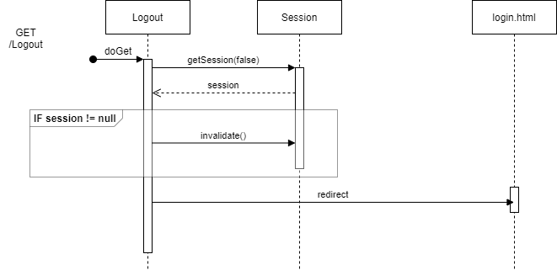
Event: logout

